Slide 1
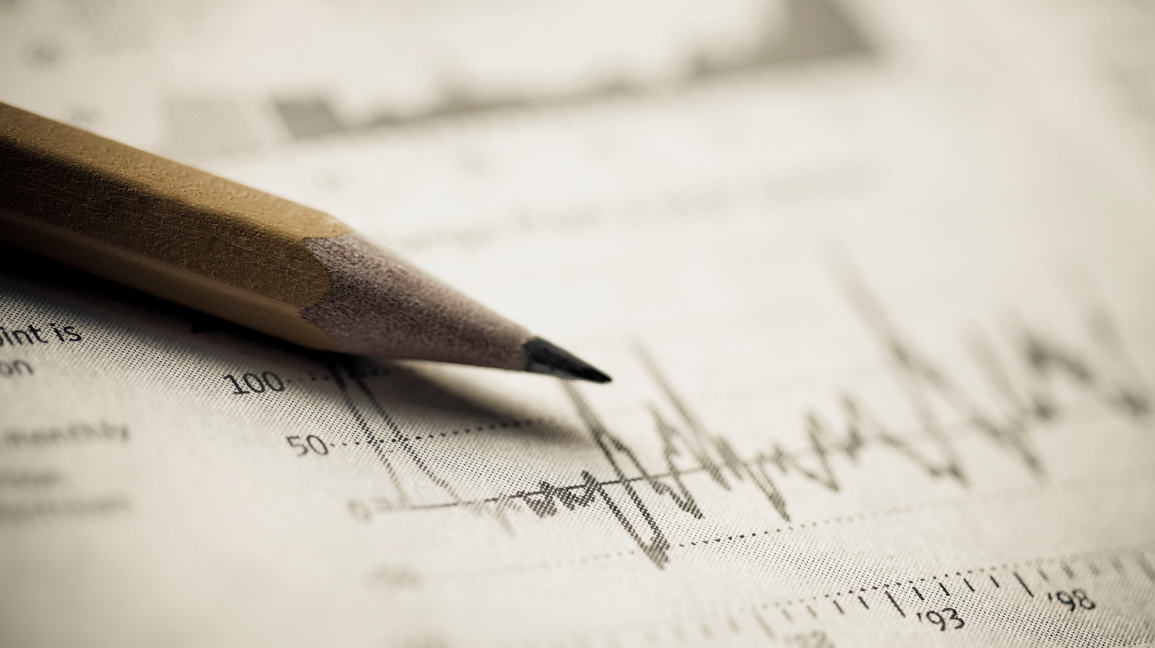
Learning Python
Power of python coding

Slide 2
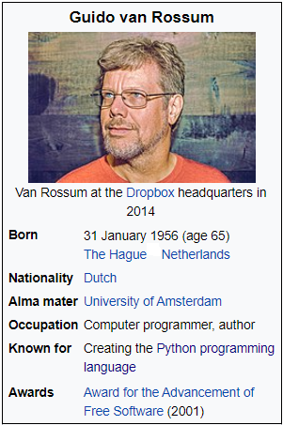
Python Introduction
Python is an interpreted and high-level programming language which was originated in the year of late 1980s but it was implemented in December 1989 by Guido Van Rossum.
The word Python came when Guido Van Rossum began implementing Python, Guido van Rossum was also reading the published scripts from “Monty Python’s Flying Circus”, a BBC comedy series from the 1970s.
Van Rossum thought he needed a name that was short, unique, and slightly mysterious, so he decided to call the language Python. According to a recent survey by Stack Overflow, Python has overtaken java in popularity.

Slide 3
Python Introduction
Python is dynamically typed, and garbage-collected language which aims to help a programmer to write clear and logical code for both small and large-scale projects.
Learning Python is good because Python is a famous programming language because it is easy to learn and use. Moreover, there is a large number of libraries available that can be used in your projects today! Some developers even consider it to be a must-known programming language.
Python is opensource which was developed under OSI-approved license, making it freely usable and distributable, even for commercial use. It means any of them can contribute to the python software.

Slide 4
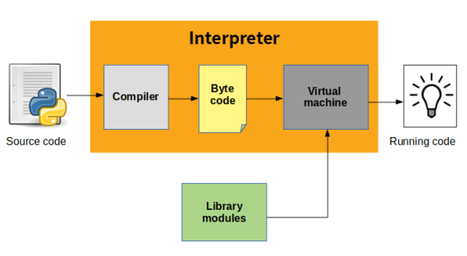
Python Interpreter
An interpreter is a kind of program that executes other programs when you write python, programs, it converts source code written by the developer into an intermediate language. Which again translated into the native language/machine language that is executed.

Slide 5
What can I do with Python
System programming
Graphical user interface programming
Internet scripting
Component integration
Database programming
Gaming , Images, XML, Robot and more

Slide 6
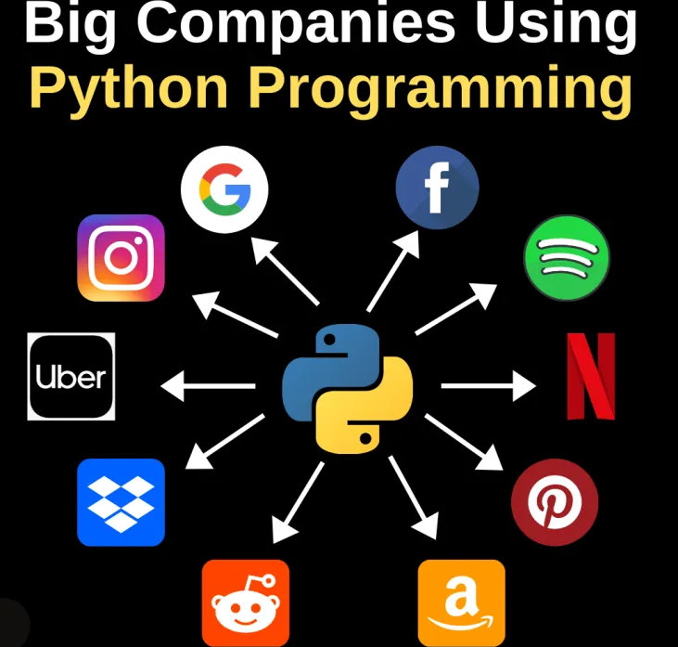
Main Applications of Python
Here are some of the main applications of Python:
Data Science
Automation
Application Development
Artificial Intelligence
Machine Learning
Web development
Business applications
Image Processing
Desktop GUI
Audio/Video Applications
Scientific Calculations
Embedded Application

Slide 7
Versions Of Python
The first version of Python was released in February 1991, and Python reached version 1.0 in January 1994 while the last version released while Van Rossum was at CWI was Python 1.2.
To check versions/version of Python installed on your system, open command prompt(terminal), type “python”, hit enter then you will see the version of python installed on your system.
Current version of python is “Python 3.9.5 released on 03 May 2021”

Slide 8
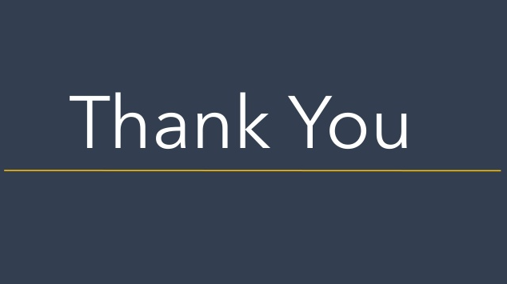
Every ending is a new Beginning   

